Slide 1
Socially Active Top Management: Do They Matter?
Initial Idea
2nd Dec 2019

Slide 2
What is the larger question?
How do messages from thought leaders, top managers and the likes and have an effect on the market performance of firms/brands?
If there is an effect, can we explain the mechanism?
Do we see a larger effect on marketing? Innovation?
Is there any differential effect for firms with socially active leaders and those without?

Slide 3
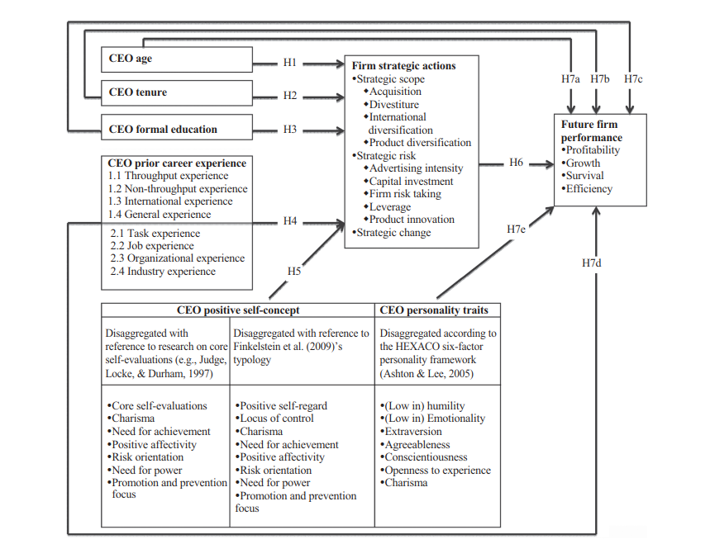
Relevant Framework
Wang, G., Holmes Jr, R. M., Oh, I. S., & Zhu, W. (2016). Do CEOs matter to firm strategic actions and firm performance? A meta‐analytic investigation based on upper echelons theory. Personnel Psychology, 69(4), 775-862.

Slide 4
Relevant Reference
Agle, B. R., Nagarajan, N. J., Sonnenfeld, J. A., & Srinivasan, D. (2006). Does CEO charisma matter? An empirical analysis of the relationships among organizational performance, environmental uncertainty, and top management team perceptions of CEO charisma. Academy of management journal, 49(1), 161-174.

Slide 5
Next Steps
Potential Data Sources
Twitter accounts of top management, firms, brands
Firm Financials
Method
Use Existing or potentially define new dictionaries to identify top management positive self-concept and personality traits (LIWC)
Use these on the text from Twitter data
Use other information (like retweets, favorites, comments, likes, etc) from twitter to account for the virality of the data
Use this to explain firm performance
Need to identify potential mediators and moderators

